Slide 1


Signal Generator And Oscilloscope Using MSP430
-Adithya Chandrasekaran
Notes:
THe signal generator allows complete user control using the push buttons and the oscilloscope can be realised
using a serial interface.

Slide 2
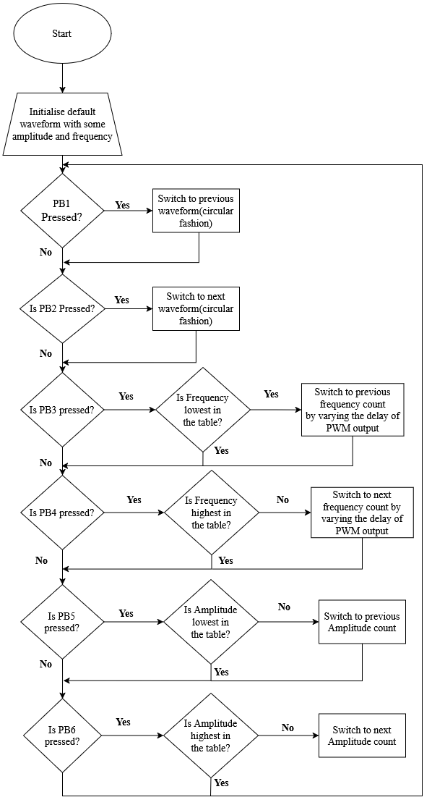
Flowchart – Signal Generator User Control
The signal is initialized to generate generates a sine wave of 1Hz and with peak to peak of 1.5V.
Push Buttons from 1-6 are continuously polled to check for any user inputs.
To control the wave generator buttons 1 or 2 can be pressed to go to the next or previous wave.
To increase the frequency button 3 and to decrease frequency button 4 can be pressed
Similarly, to decrease the amplitude button 5 and to increase amplitude button 6 can be pressed
The Output can be observed on the SerialPlot tool.
Notes:
Buttons PB1-PB6 are polled continuously so that the relevant action can be taken accordingly.
Explain PB1-6

Slide 3
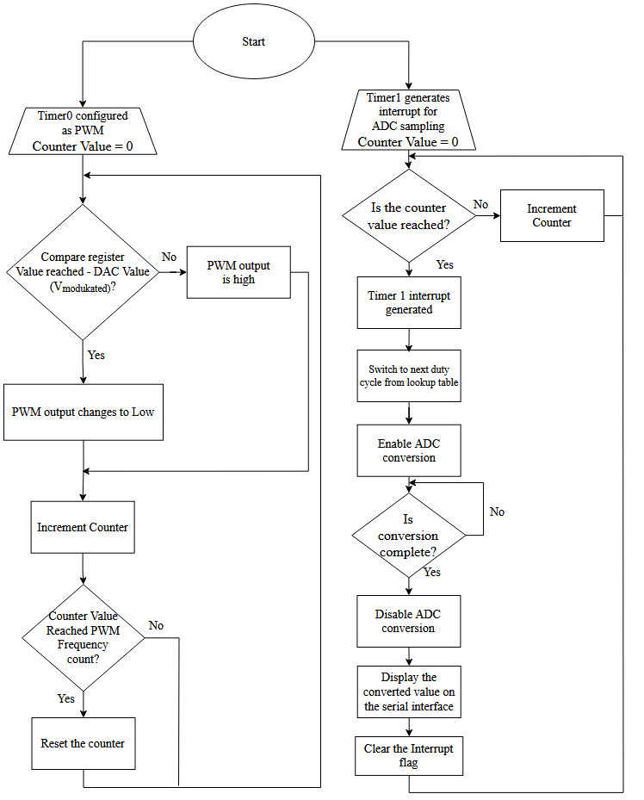
Flowchart – Signal Generator And Oscilloscope Working
Look up tables are used to generate waves, alter frequency and the amplitude.
Timer 0 is configured as a PWM(10KHz), to generate waves (sine, trapezoid or rectangular).
Timer 1 is used to generate the frequency of the wave and to perform ADC sampling at the same frequency.
To generate a wave, we iterate from 0th position to the 15th position in the lookup table. This value is updated each time a timer 1 interrupt is generated.
Timer 1 interrupt occurs at the frequency chosen by the user. The output wave can be observed both in the oscilloscope and the serial interface.
Notes:
The PWM output toggles between high and low based on the comparison of the register value with the
DAC (modulated) value i.e. values calculated with the help of the look up table Timer1 for ADC Sampling
Timer1 generates an interrupt for ADC sampling with a counter value based on the frequency lookup table:
for example the sampling frequency for 3Hz is fsample = 3 * 16 = 48Hz which
approximatley takes 21us for each interrupt
When the interrupt is triggered:
ADC conversion is enabled.
The duty cycle is also updated at this interrupt
Once the conversion is complete, ADC is disabled, and the interrupt flag is cleared.

Slide 4
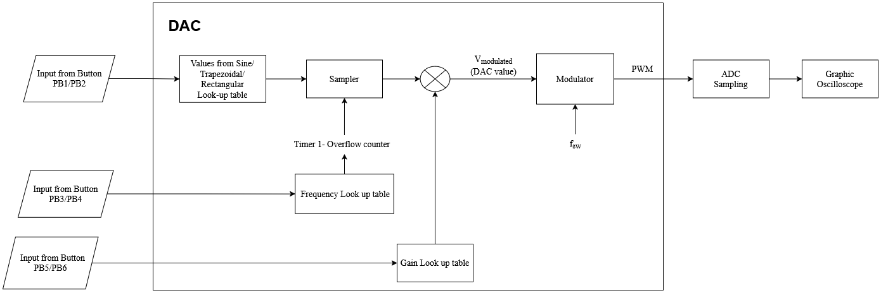
Functional Block Diagram

Slide 5
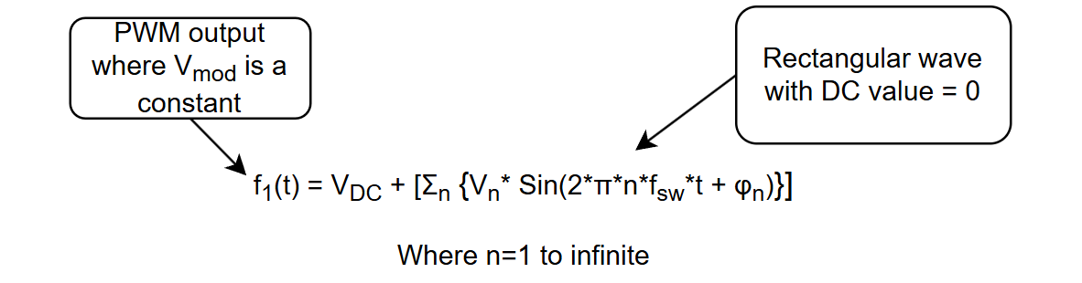
Theoretical Explanation
A square wave can be represented by the sum of the DC value and the sum of all sine harmonics and can be represented by:
In the code the switching frequency is 10khz and we observe a ~1.5V DC shift as the PWM ranges (~0V- 3V)

Slide 6
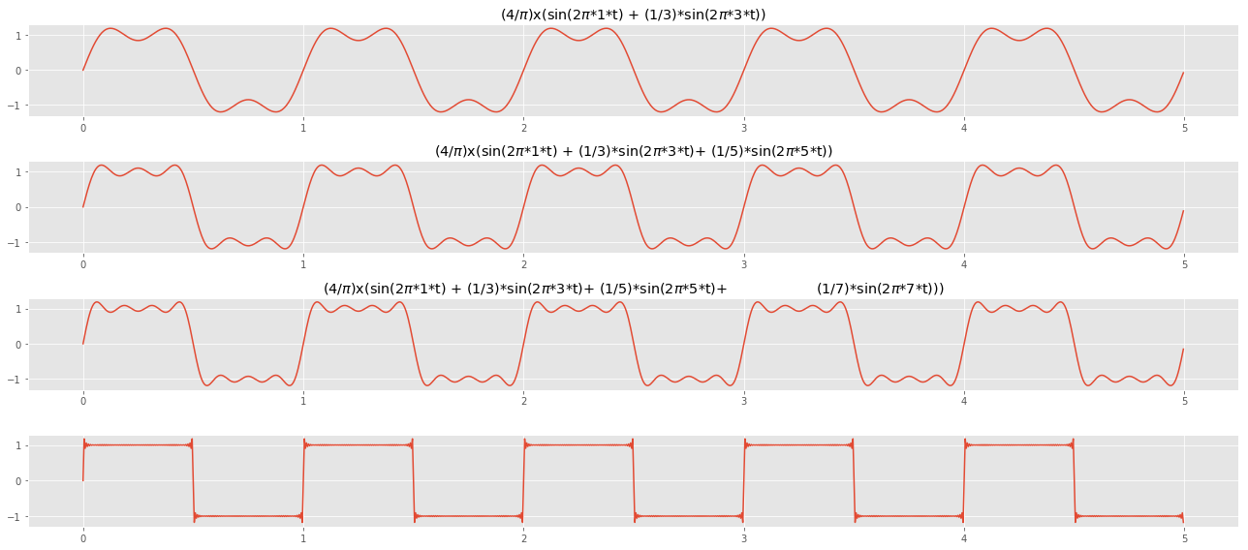
Figure : Visualisation of square wave being the sum of infinite sine harmonics. Image source

Slide 7
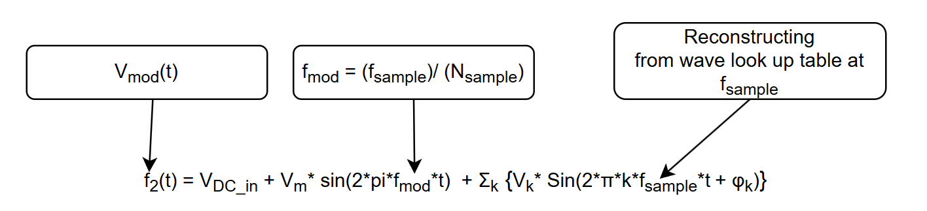
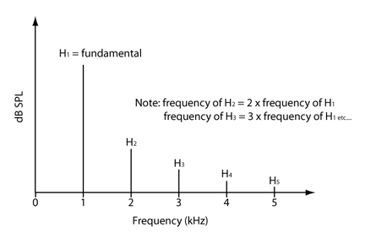
Theoretical Explanation Continued
The modulating frequency (desired frequency that we want at the output) has the sine wave along with its harmonics and can be represented as:
Figure: All the harmonics is represented using the above plot Image source
Notes:
Modulating frequency is the desired output

Slide 8
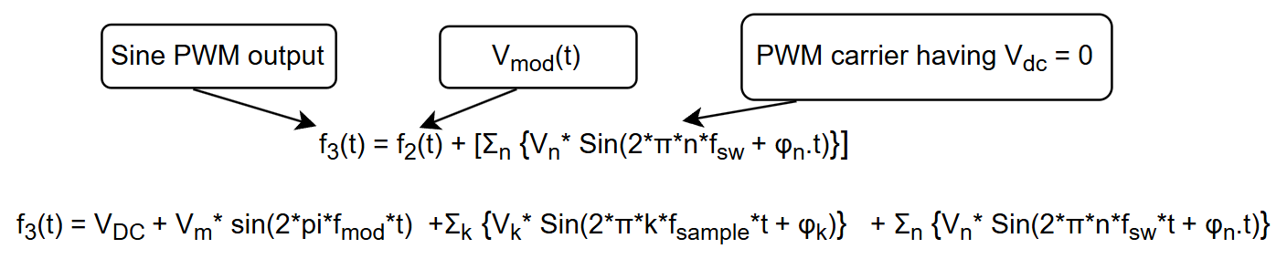
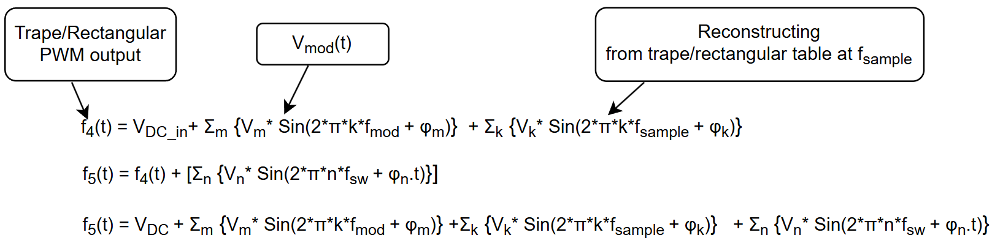
Theoretical Explanation Continued
Finally our sine PWM has the following components, i.e., the DC voltage, the harmonic components of the PWM (switching frequency) and modulating frequency with its harmonics.
Similarly we can construct the equation for trapezoidal wave and sine wave which would look like

Slide 9
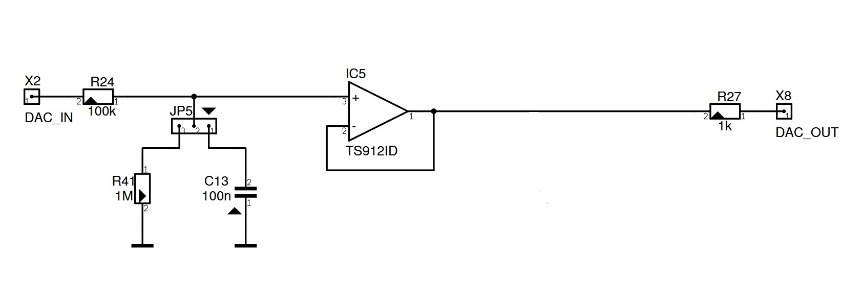
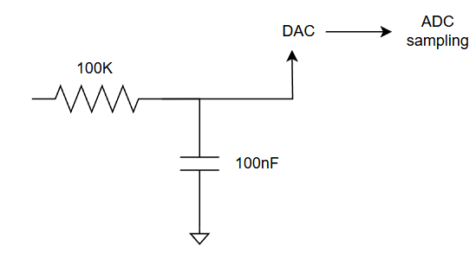
Filter Input and output and ADC
Figure: Op Amp circuit to which the sine/ trapezoid/ rectangular PWM is fed
Figure: Filtered DAC output (only modulated signal is extracted) can be sampled by an ADC to be plotted in a serial interface

Slide 10
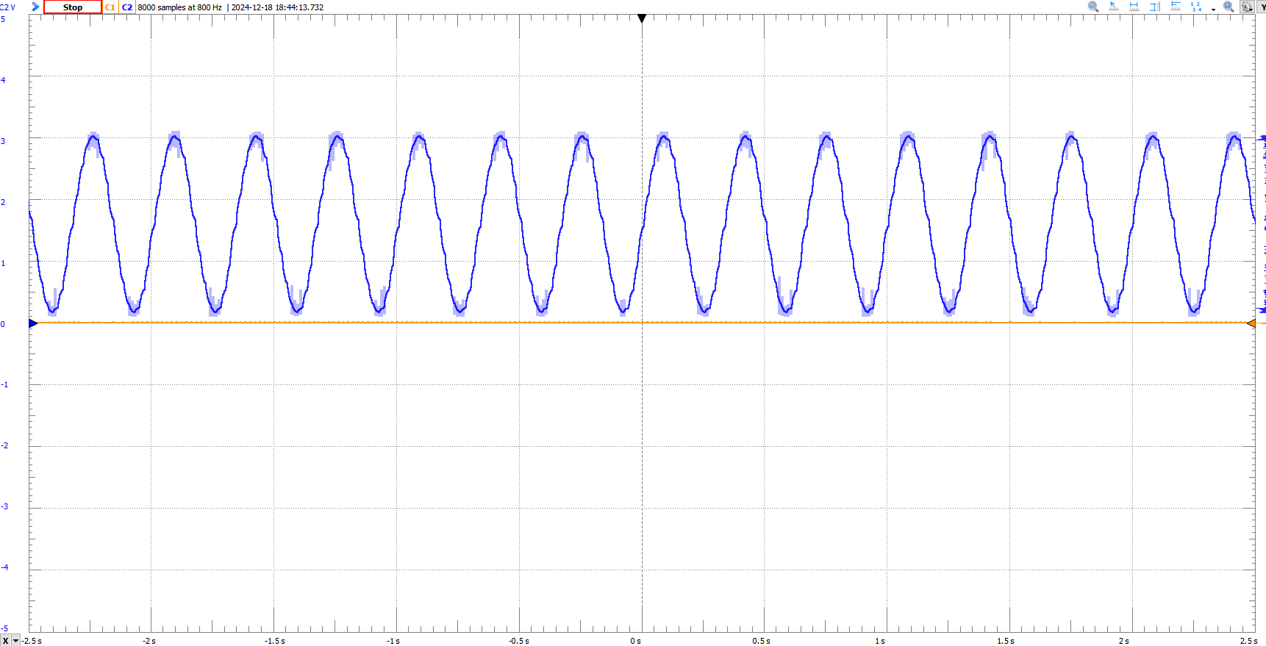
Example Output Observed On The Scope
Fig: 3Hz Sine wave observed on the scope

Slide 11
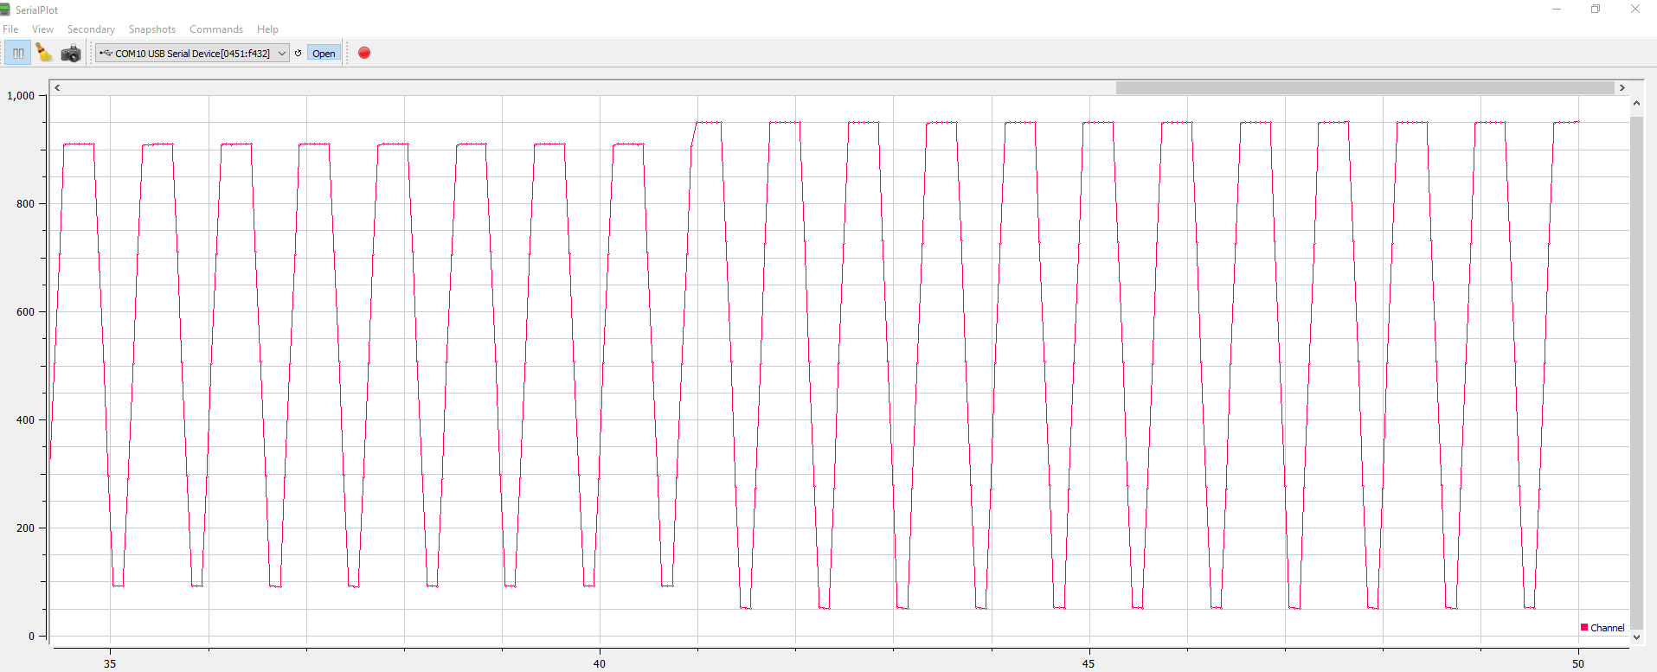
Example Output Observed On SerialPlot
Fig: Trapezoidal wave by varying Amplitude

Slide 12
References
https://dipsingh.github.io/Back-to-basics-communication/
https://tikz.net/fourier_series/
https://www.listeninc.com/resources/technical-notes/harmonic-distortion-measurement-the-effects-of-sampling-rate-and-stimulus-frequency-on-the-measured-harmonic-frequency-including-thd-and-rub-buzz/

Slide 13
THANK YOU

